Slide 1
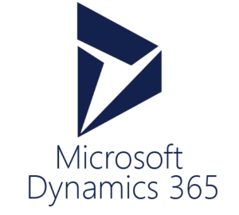
ITLec
Information technology
lectures
http://www.MSDynamicsArab.com
By ITLec.com
https://www.meetup.com/Riyadh-Customer-Relationship-Management-Meetup/

Slide 2
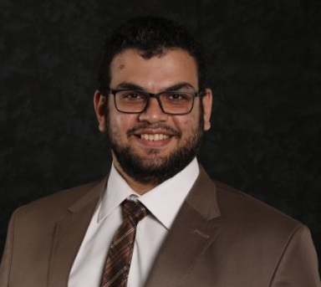
About Me
Rasheed Gomaa
Tech. Lead/ Techno-Functional Consultant
Multi-Culture experience (Australia ,USA, Dubai, Saudi, ..).
+35 Successful Project
Nuget (+400K) https://www.nuget.org/profiles/ITLec
Github (+15 Repositories) https://github.com/ITLec
https://twitter.com/Rasheed_ITLec
Rasheed@ITLec.com

Slide 3
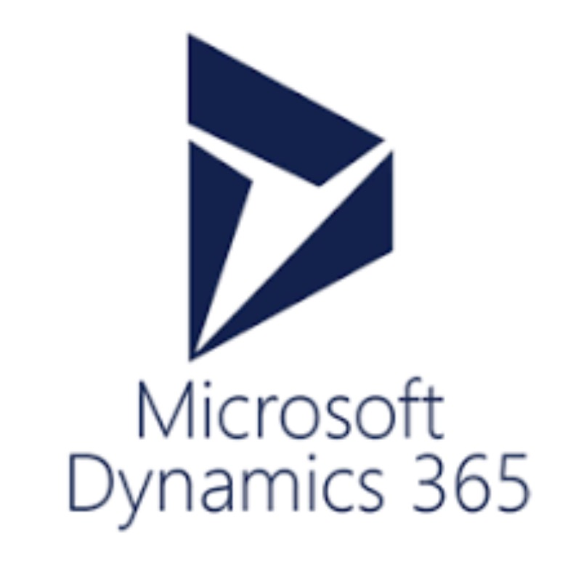
Dynamics 365 Sales - Marketing
Patient/ Client/ Doctors/ Internal Stuff(Individual / Corporate)
Activities/ Custom Activities
Marketing Playbook
Marketing Segmentation
Marketing List (Static/ Dynamics)
Campaign/ Quick Campaign
Marketing/ Collaboration Dashboard
Activities Calendar
Out of the Box Features

Slide 4
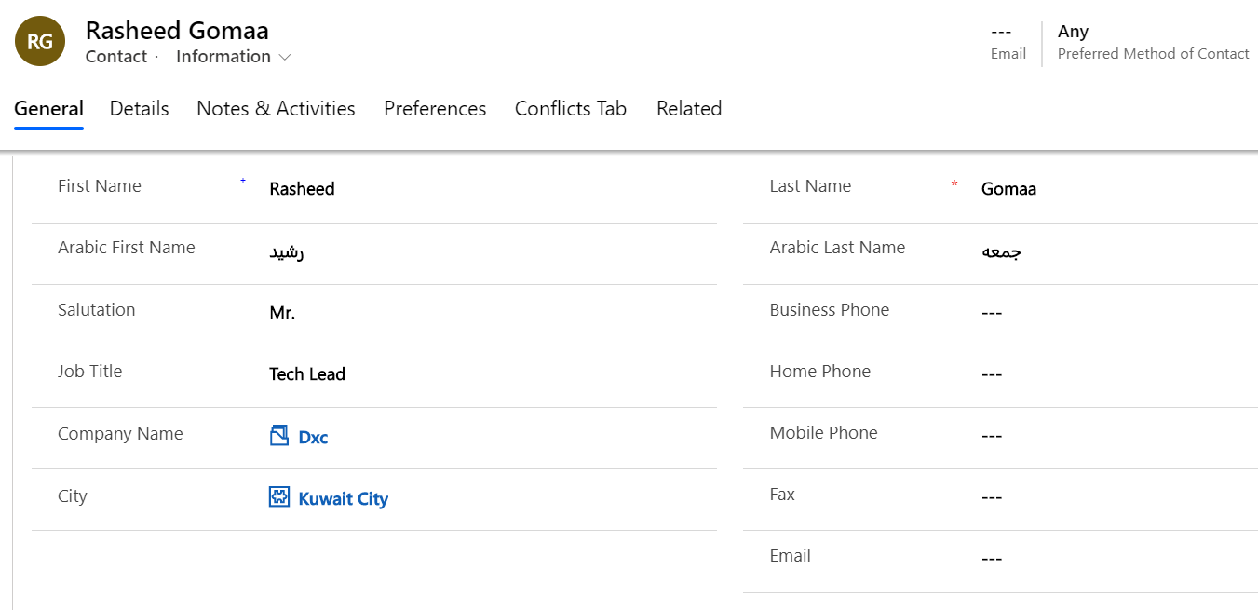
Patient/ Client/ Doctors/ Stuff/ (Individual / Corporate)
Full Information Container
Contact Preferences
Contact Type
Basic Medical Profile
Files
…

Slide 5
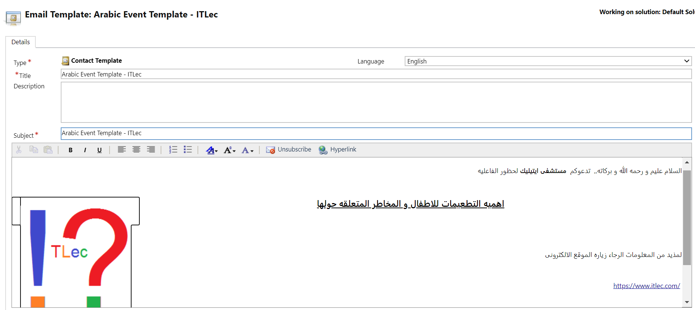
Activities
Task
Email/ Email Template
Phone Call(In/ Out)
Letter
Fax
Appointment/ Event
Convert To/ Promote
Notes:
Owner (User/ Team)
Due Date
Recurrence

Slide 6
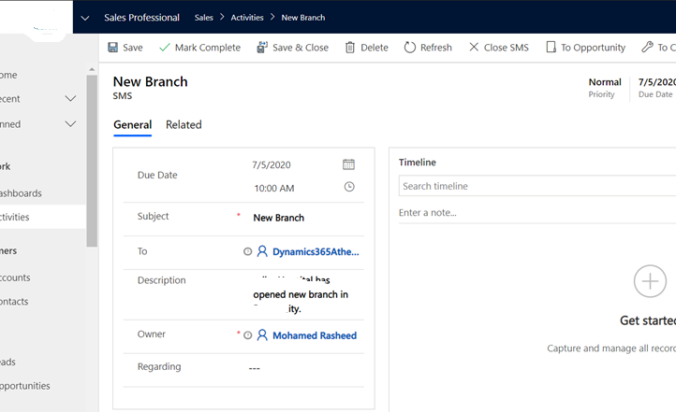
Custom Activities
SMS
Whatsapp
Communication channel
…
Notes:
This part is not in the proposal, but can be customized
SMS can be sent to party list:-
Example:-
To: Mohamed Rasheed
Subject: Customer SMS
Description (Full Message): New Branch is ready to serve you.

Slide 7
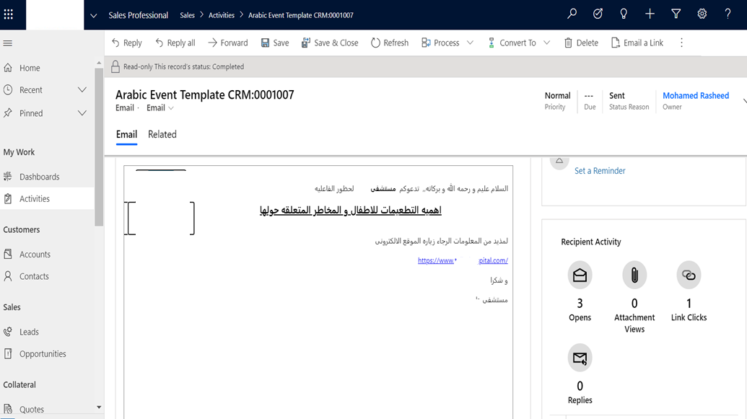
Email Engagement
Opens
Attachment views
Link Clicks
Replies
Notes:
For public, not patient experience
This part is not in the proposal, but can be customized.
Need email configuration + Sharepoint + OneDrive

Slide 8
Segmentation
Gender
City/ Area
Age
Nationality
Recent visit info
Company
Medical Department
…

Slide 9
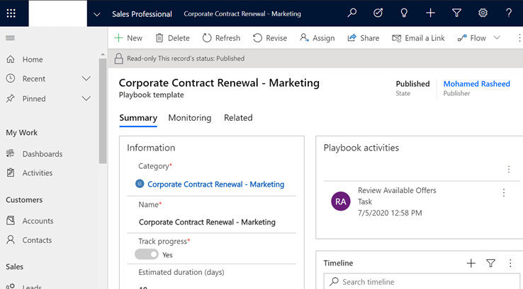
Marketing Playbook
Playbook category
Playbook template
Playbook activities
Launch playbook
Notes:
Category: Corporate Contract Renewal - Marketing Playbook activities:-
1- Review Offers
2- Communicate new offers
Select Account
Publish Playbook
In Account Launch playbook button

Slide 10
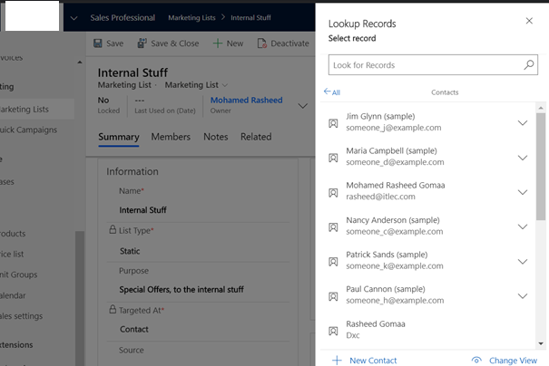
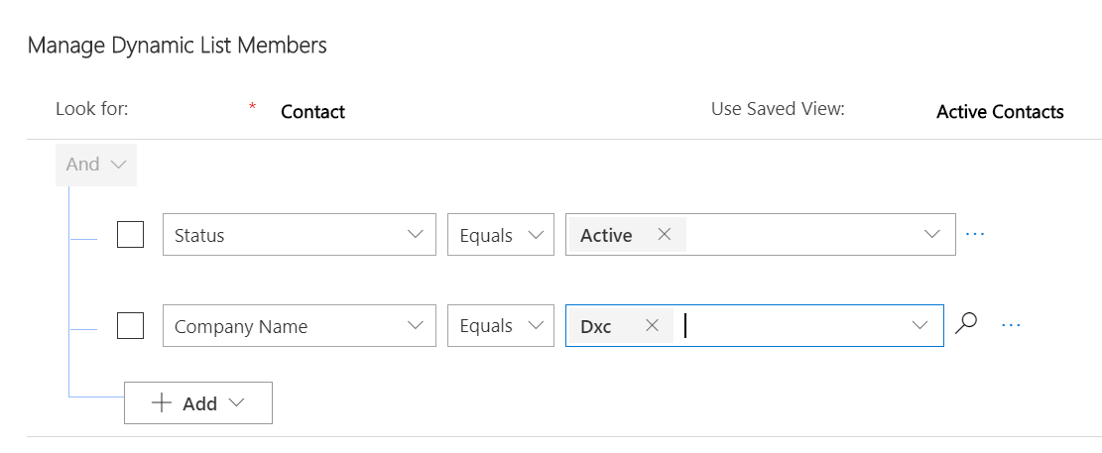
Marketing List
Manage Members
Static
Dynamics
Copy to Static
Create Quick Campaign

Slide 11
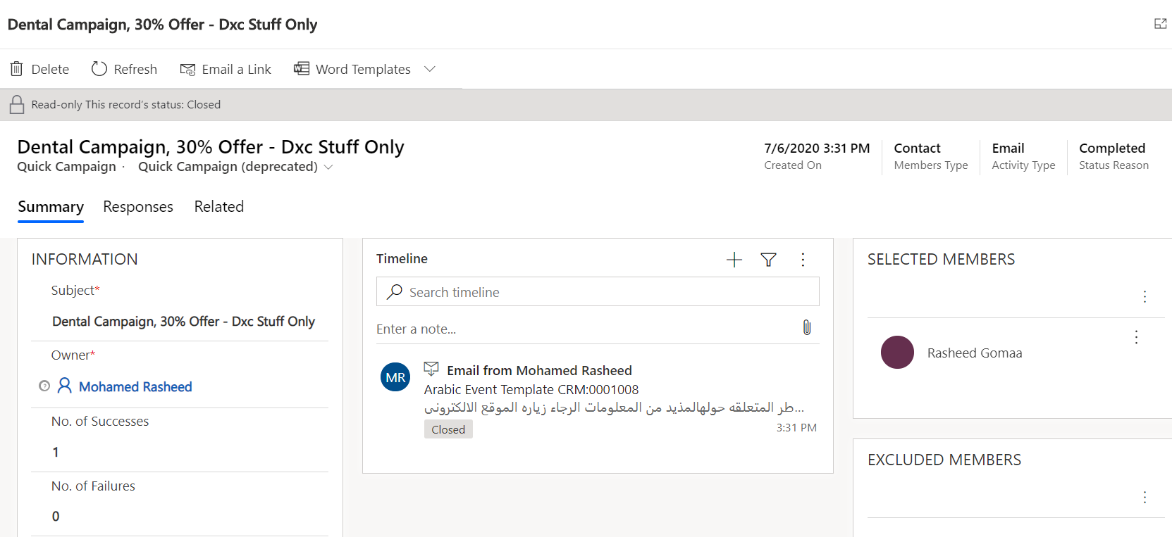
Quick Campaign
From Marketing List
From Views
One Activity
Assign to (User, team, Queue)
Notes:
1- Navigate to Marketing list
2- Click Create quick campaign button
3- Name: Dental Campaign, 30% Offer - Dxc Stuff Only

Slide 12
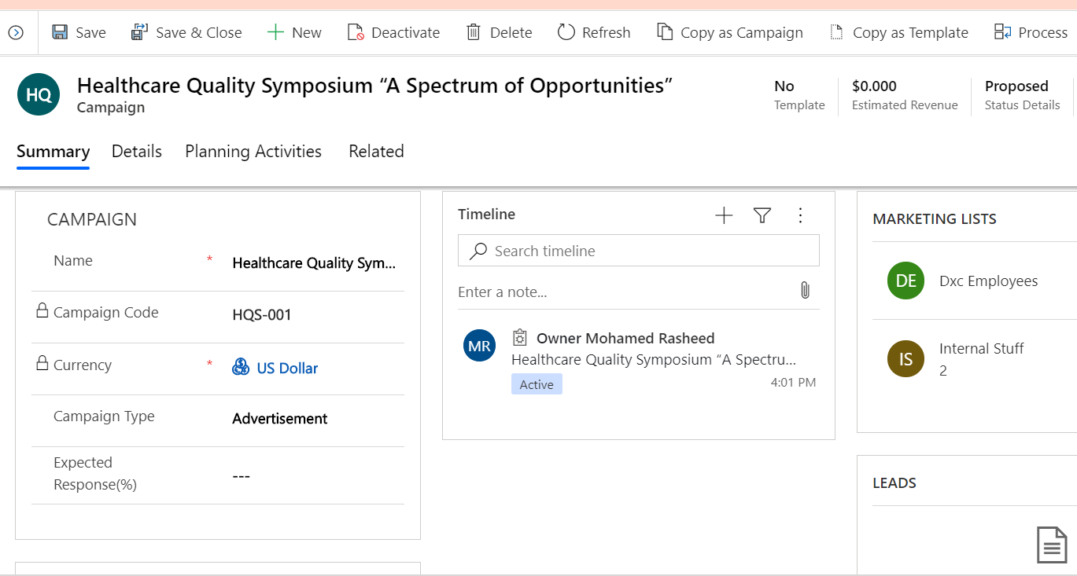
Campaign
Campaign Template
Campaign Code
Campaign Type
Campaign Activity
Multiple Marketing List
Multiple Activities
Financial
Status Details
Campaign Response
Copy as Campaign

Slide 13
Scenario COVID19 Vaccination event & Campaign
1- 1 TV appointment:-
a. SMS campaign, to all internal stuff.
2- 20 TV advertisements
3- SMS to all internal stuff + Active patients
4- General event mail
5- 1 Lecture, Public invitation:-
a. Mail campaign, before 5 days.
b. Mail campaign, before 3 days.
c. SMS campaign, before 1 day.

Slide 14
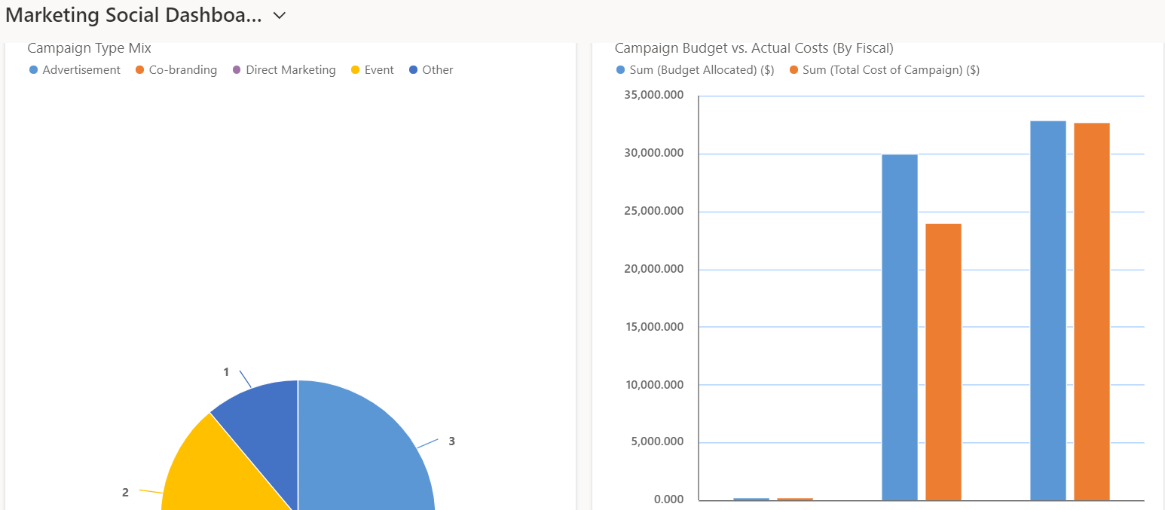
Marketing Dashboard
Charts
Grids
Entity Dashboard

Slide 15
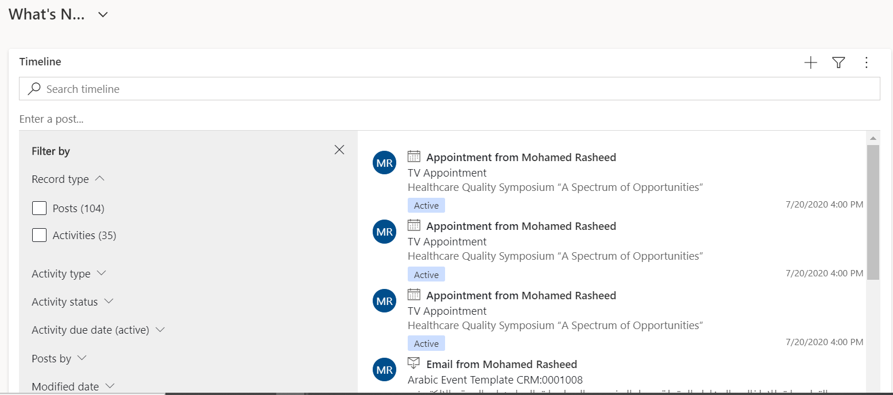
Collaboration Dashboard
Posts
Activities
@ Mention
Advanced Filter

Slide 16
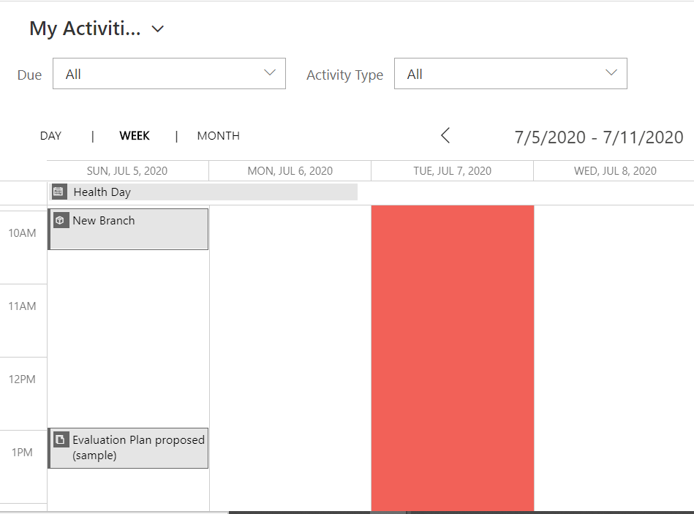
Activities Calendar

Slide 17
Out of the Box Features
Advanced Filter
Integration with Word
Integration with Excel
SSRS Reports
Power BI Reports
Views
Mobile Integration
Power Platform

